Slide 1
Micro Credit Loan Defaulter Project Presentation
Submitted By
Benjamin Emmanuel
Data Science Intern at Flip Robo Technologies

Slide 2
Introduction
Problem Statement:
A Microfinance Institution (MFI) is an organization that offers financial services to low income populations. MFS becomes very useful when targeting especially the unbanked poor families living in remote areas with not much sources of income. The Microfinance services (MFS) provided by MFI are Group Loans, Agricultural Loans, Individual Business Loans and so on. Many microfinance institutions (MFI), experts and donors are supporting the idea of using mobile financial services (MFS) which they feel are more convenient and efficient, and cost saving, than the traditional high-touch model used since long for the purpose of delivering microfinance services. Though, the MFI industry is primarily focusing on low income families and are very useful in such areas, the implementation of MFS has been uneven with both significant challenges and successes.

Slide 3
Introduction
Microfinance is now widely recognized as a strategy for poverty reduction, with $70 billion in outstanding loans and a global client base of 200 million people. We are now working with a client in the telecom industry. They are a provider of fixed wireless telecommunications networks. They've released a number of products and built their business and organization around the budget operator model, which entails providing better products at lower prices to all value-conscious clients via a disruptive innovation strategy that focuses on the subscriber. They recognize the value of communication and how it influences a person's life, thus they focus on giving low-income families and impoverished consumers with services and products that can assist them in their time of need. They're working with a partner.

Slide 4

TO DO
Build a model which can be used to predict in terms of a probability for each loan transaction, whether the customer will be paying back the loaned amount within 5 days of insurance of loan.
In this case, Label ‘1’ indicates that the loan has been paid i.e. Non- defaulter, while, Label ‘0’ indicates that the loan has not been paid i.e. defaulter.

Slide 5
Points to remember
There are no null values in the dataset.
There may be some customers with no loan history.
The dataset is imbalanced. Label ‘1’ has approximately 87.5 percent records, while, label ‘0’ has approximately 12.5 percent records.
For some features, there may be values which might not be realistic. You may have to observe them and treat them with a suitable explanation.
You might come across outliers in some features which you need to handle as per your understanding. Keep in mind that data is expensive and we cannot lose more than 7-8 percent of the total data.

Slide 6
Project Goals
Analytical Problem Framing
Exploratory Data Analysis (EDA)
Visualizations
Data Pre-Processing on train and test datasets
Model/s Development and Evaluation
Performing hyper parameter tuning, saving the best model and predicting the label
Conclusion and future work discussion

Slide 7
Technology
Hardware Used:
RAM: 16 GB
Intel(R) Core(TM) i7-9750H CPU @ 2.60GHz 2.59
Software Used:
Programming language: Python
Distribution: Anaconda Navigator
Browser based language shell: Jupyter Notebook
Libraries/Packages Used:
Pandas, NumPy, matplotlib, seaborn, scikit-learn

Slide 8
Data Description
label : Flag indicating whether the user paid back the credit amount within 5 days of issuing the loan
{1:success, 0:failure}
msisdn : Mobile number of user
aon : Age on cellular network in days
daily_decr30 : Daily amount spent from main account, averaged over last 30 days (in Indonesian Rupiah)
daily_decr90 : Daily amount spent from main account, averaged over last 90 days (in Indonesian Rupiah)
rental30 : Average main account balance over last 30 days
rental90 : Average main account balance over last 90 days
last_rech_date_ma : Number of days till last recharge of main account
last_rech_date_da : Number of days till last recharge of data account
last_rech_amt_ma : Amount of last recharge of main account (in Indonesian Rupiah)
cnt_ma_rech30 : Number of times main account got recharged in last 30 days
fr_ma_rech30 : Frequency of main account recharged in last 30 days

Slide 9
Data Description
sumamnt_ma_rech30 : Total amount of recharge in main account over last 30 days (in Indonesian Rupiah)
medianamnt_ma_rech30 : Median of amount of recharges done in main account over last 30 days at user level (in Indonesian Rupiah)
medianmarechprebal30 : Median of main account balance just before recharge in last 30 days at user level (in Indonesian Rupiah)
cnt_ma_rech90 : Number of times main account got recharged in last 90 days
fr_ma_rech90 : Frequency of main account recharged in last 90 days
sumamnt_ma_rech90 : Total amount of recharge in main account over last 90 days (in Indonesian Rupiah)
medianamnt_ma_rech90 : Median of amount of recharges done in main account over last 90 days at user level (in Indonesian Rupiah)
medianmarechprebal90 : Median of main account balance just before recharge in last 90 days at user level (in Indonesian Rupiah)
cnt_da_rech30 : Number of times data account got recharged in last 30 days
fr_da_rech30 : Frequency of data account recharged in last 30 days
cnt_da_rech90 : Number of times data account got recharged in last 90 days

Slide 10
Data Description
fr_da_rech90 : Frequency of data account recharged in last 90 days
cnt_loans30 : Number of loans taken by user in last 30 days
amnt_loans30 : Total amount of loans taken by user in last 30 days
maxamnt_loans30 : Maximum amount of loan taken by the user in last 30 days
medianamnt_loans30: Median of amounts of loan taken by the user in last 30 days
cnt_loans90 : Number of loans taken by user in last 90 days
amnt_loans90 : Total amount of loans taken by user in last 90 days
maxamnt_loans90 : Maximum amount of loan taken by the user in last 90 days
medianamnt_loans90: Median of amounts of loan taken by the user in last 90 days
payback30 : Average payback time in days over last 30 days
payback90 : Average payback time in days over last 90 days
pcircle : Telecom circle
pdate : Date

Slide 11
Exploratory Data Analysis
Shape : 2,09,593 rows and 37 columns
No null values present
Only one duplicate row/record found
Datatypes of float, integer and object are in dataset
First, I loaded the complete dataset into our Jupyter Notebook after importing the appropriate libraries and renaming the project file from untitled.
Then I looked at the layout of our data and saw that we have 2,09,593 rows and 37 different columns.
In our dataset, there are no null or missing values.
I discovered that our data set has columns with float, integer, and object data type values by looking at the data types.

Slide 12
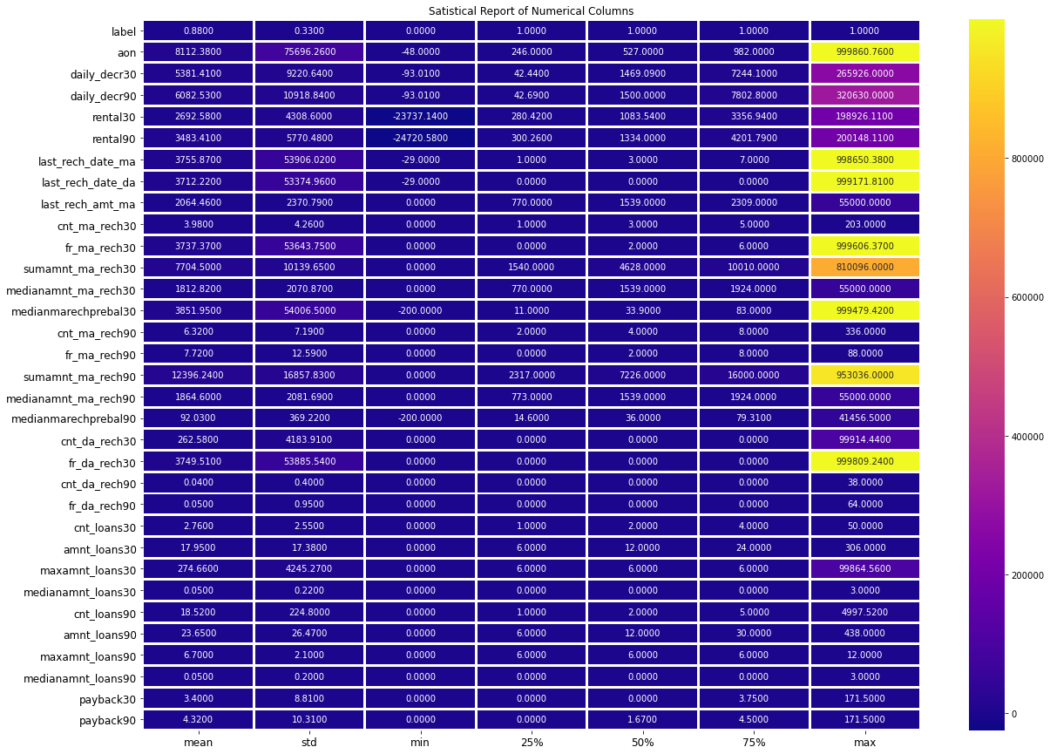
Describe
A statistical representation of all the numeric data columns can be found here.

Slide 13
CountPlot
I was able to determine the total number of rows covered by each unique category value contained in all columns of our dataset using count plots. I made sure that the proportion of data coverage is presented with the overall row number.

Slide 14
BarPlot
We can observe the success and failure label data for the columns, which is basically the feature data, using Bar Plot.

Slide 15
LinePlot
I tested the object data type for date and mobile number data in our dataset using line plots.

Slide 16
ScatterPlot
We evaluated the success and failure label data points, as well as their variances and distributions, using the scatter plot to confirm further analysis and outlier data.

Slide 17
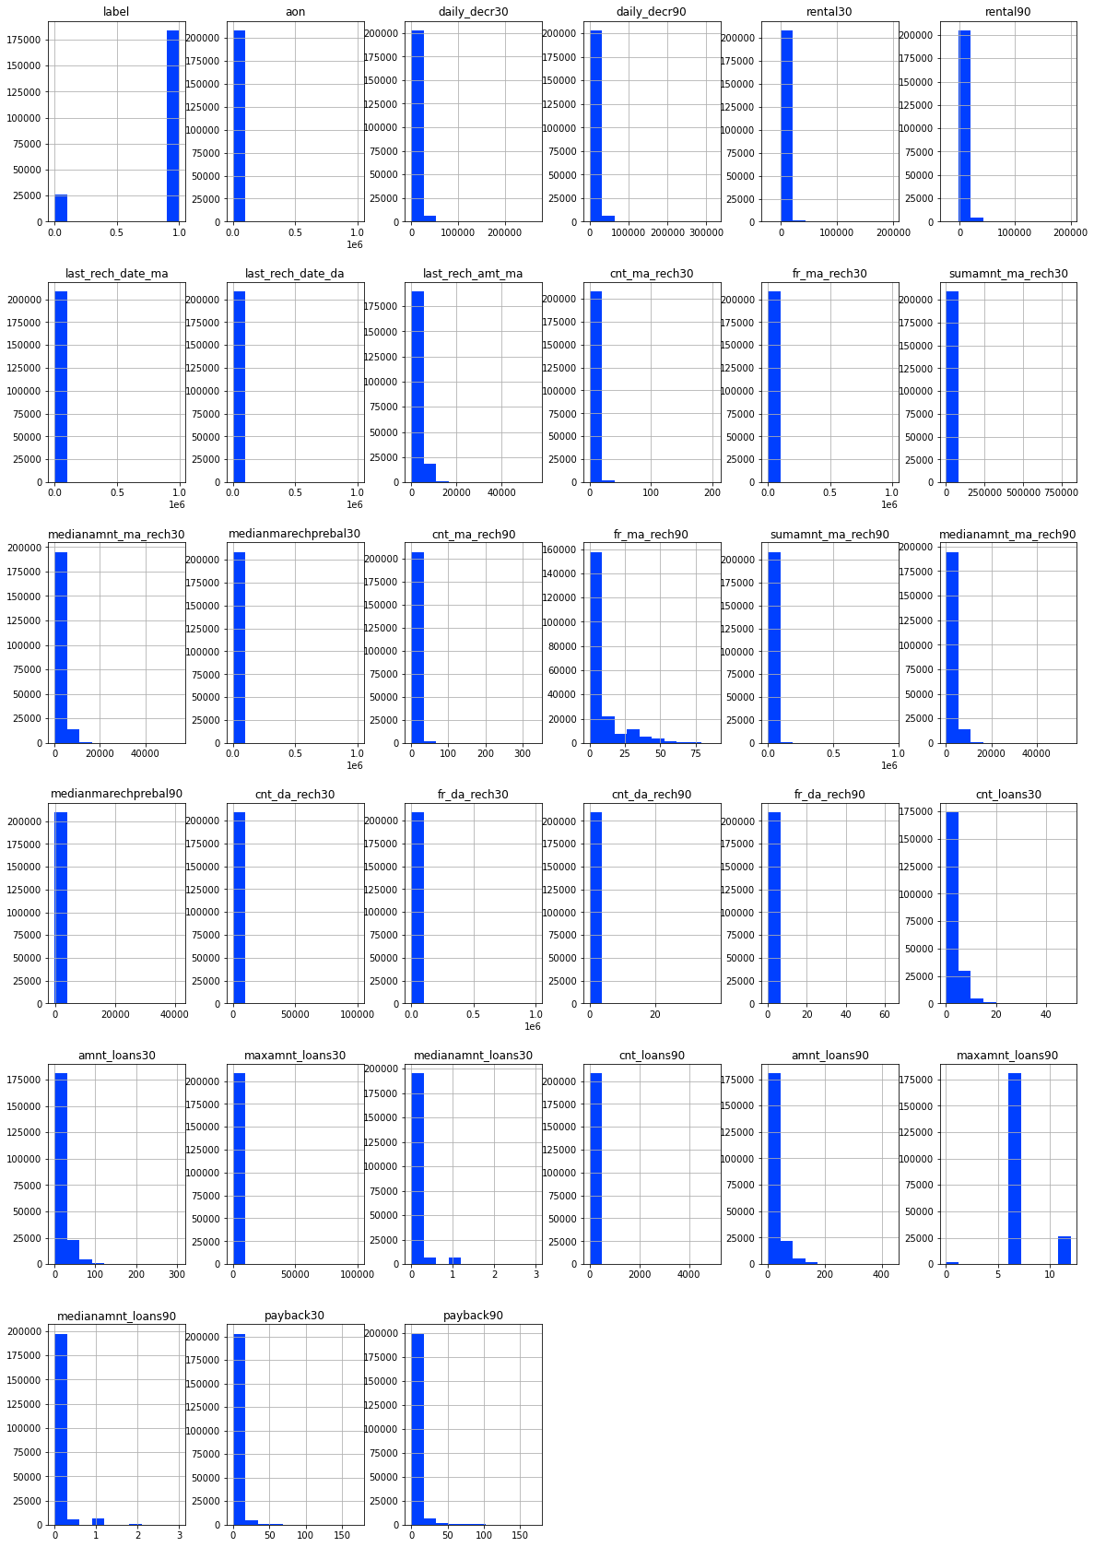
Histogram
I checked all of the column details with the histogram to ensure that the distribution was displayed for additional investigation.

Slide 18
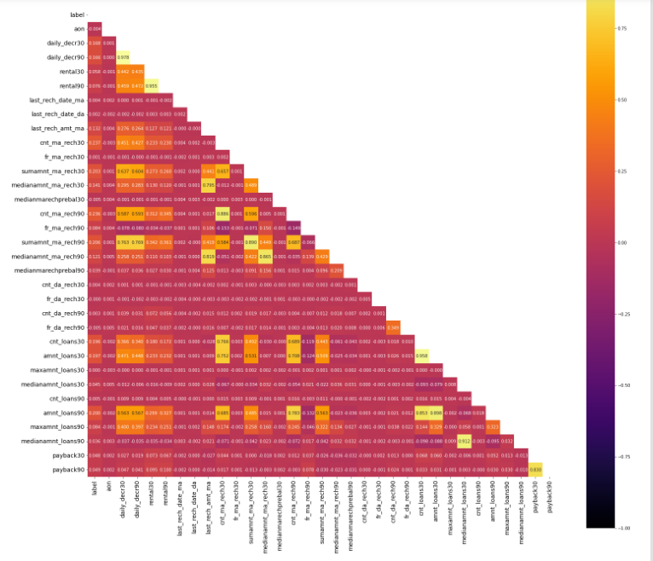
HeatMap
The heatmap was used to assess the association between the label and feature data columns in particular.We also looked for any issues about multicollinearity in the data from feature columns.

Slide 19
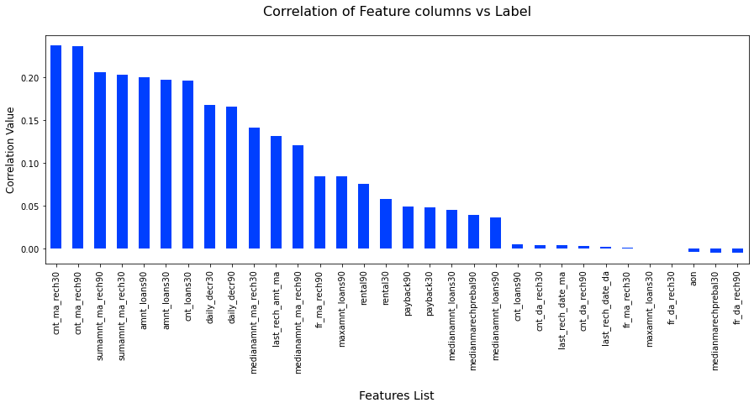
Correlation Bar
We used a Bar Plot to look at the correlation between the label and feature columns to see which are positively and negatively associated.

Slide 20
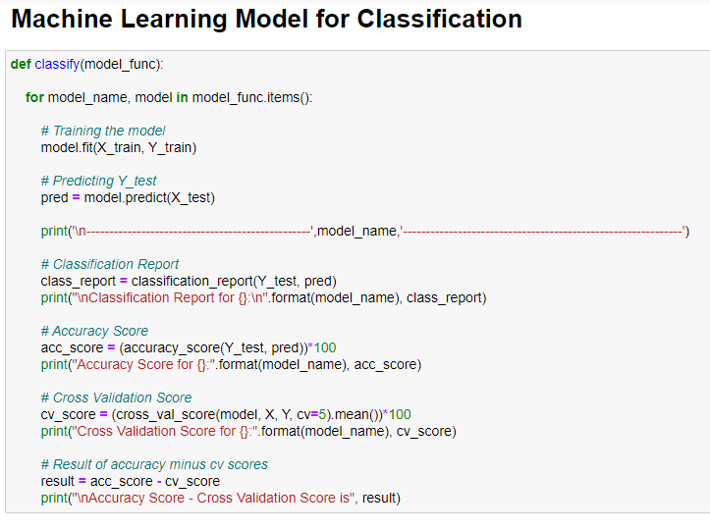
Classification Function
To minimise overfitting and underfitting concerns, I designed this classification function to retrieve the various input model characteristics as well as metric information on accuracy, cross validation, the classification report, and the difference between accuracy and cross validation using 5 folds.

Slide 21
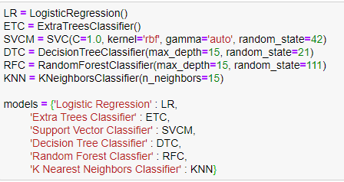
Classification Machine Learning Models Used
To verify for the greatest accuracy and cross validation score, I used 6 Classification Machine Learning Models.

Slide 22
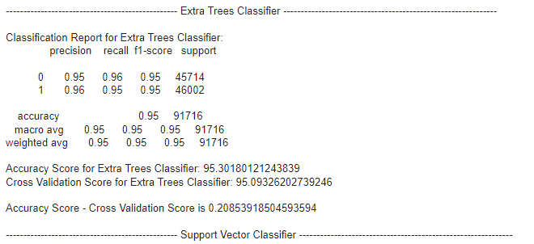
Report on Best Model
I chose Extra Trees Classifier as my best model and then proceed to perform hyper parameter tuning on the same

Slide 23
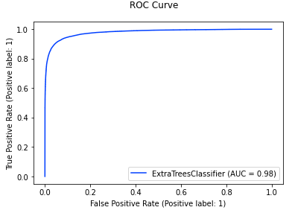
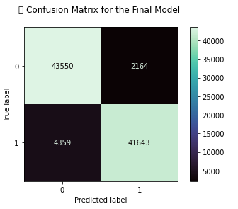
Hyper parameter tuning result

Slide 24
Conclusion
The study's key findings and conclusions are that based on the numerous variables taken into account, an MFI can determine whether a person will return money or not, and whether or not an MFI should issue a load to that individual.
Learning Outcomes of the Study in Data Science: To improve accuracy, I developed many classification models rather than relying on a single model, and I used cross validation comparison to guarantee that the model did not suffer from overfitting or underfitting. To improve the scores, I chose the best one and did hyper parameter tuning on it.

Slide 25
Limitations of this work and Scope for Future Work
The limitation is that it will only function for this specific use case, and it will need to be tweaked if used in a new scenario on a similar scale.
The scope is that we can use it in companies to determine whether we should provide a loan to a person or not, and we can also make predictions about a person purchasing an expensive service based on personal details that we have in this dataset, such as the number of times the data account has been recharged in the last 30 days and the daily amount spent from the main account, averaged over the last 30 days (in Indonesian Rupiah), so even a marketing firm can use it.

Slide 26


